Slide 1
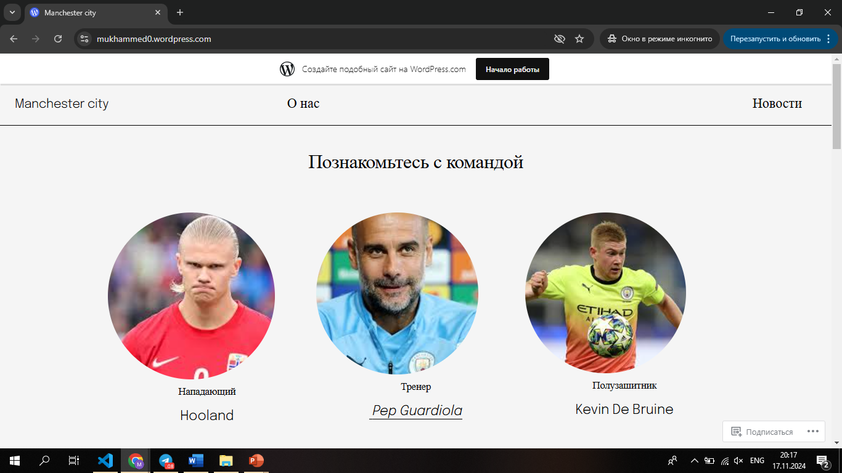
Site on wordpress
Link: https://mukhammed0.wordpress.com/

Slide 2
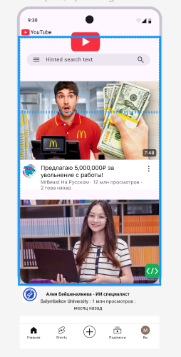
Figma
Link: https://www.figma.com/design/zVw5LnTJePtLFDCpDc3Ylz/Untitled?node-id=0-1&t=sZeNEg3VbuFANbAr-1

